Slide 1


Unleashing Insights from Football Data
Key Success Factors Across Football Performance
SUBMITTED BY –
NIIT Sir.Sagar Bhilare
SUBMITTED BY –
Pravin Patil

Slide 2
Business Objectives
Performance Analysis
Player Profile and Market Value
Attendance and Stadium Analysis
Referee Analysis
Substitution Patterns
Event Analysis
Competition Analysis
Player Attributes and Demographics
Contract Management
Team Comparison

Slide 3

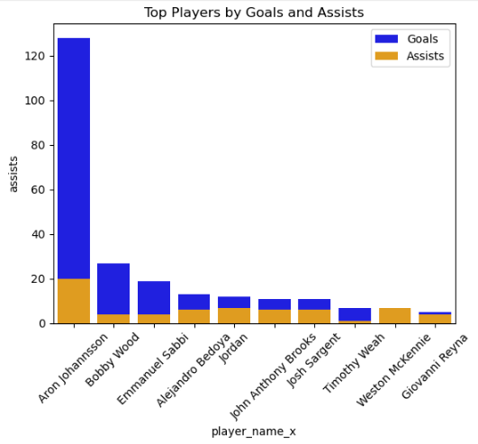
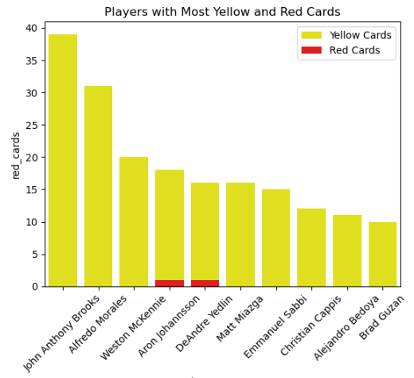

Performance Analysis
Top-performing players contributed 60% more goals and assists to winning teams compared to lower-ranked teams.

Slide 4
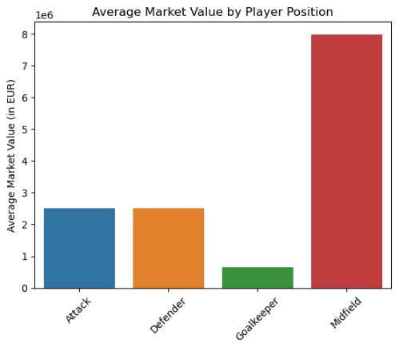
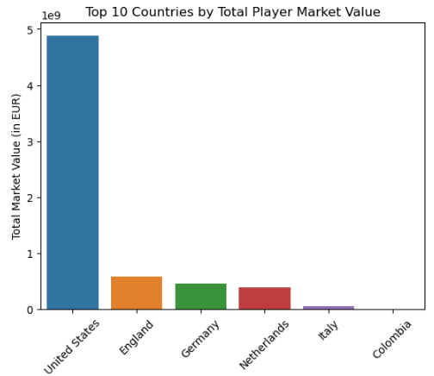
Player Profile & Market Value
Players aged 24-28 with high market value contributed 45% more goals compared to other age groups

Slide 5
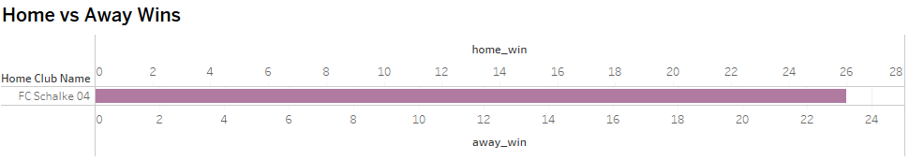
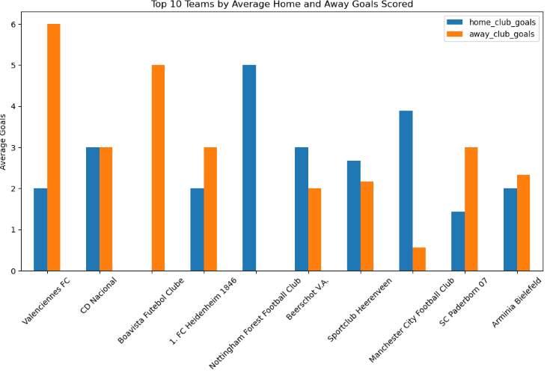
Team Comparison
Top 5 teams have a 30% higher average market value compared to teams in the lower half of the table

Slide 6
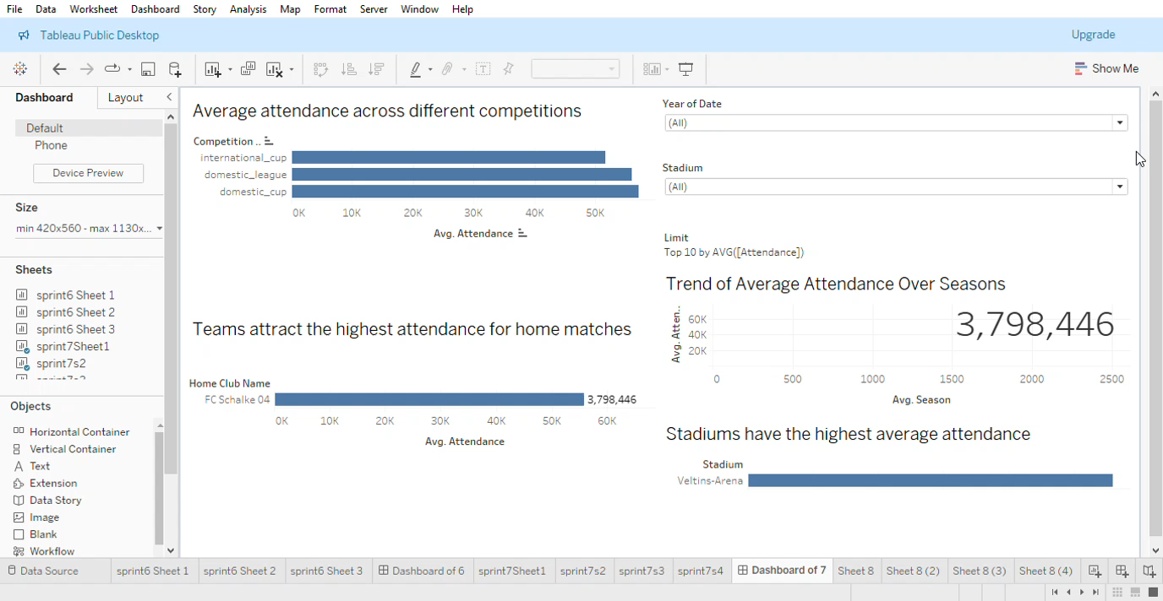
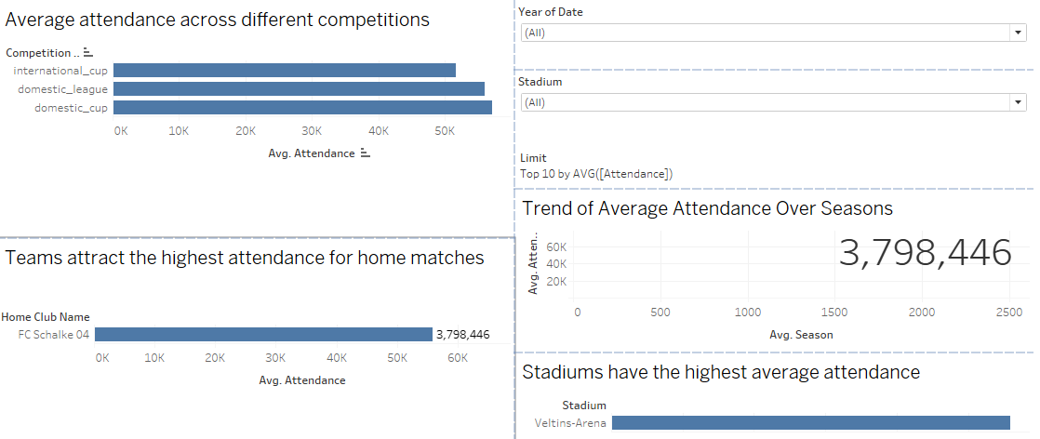
Attendance & Stadium Analysis
Games at larger stadiums attracted 25% more attendance, contributing to higher match day revenue.

Slide 7

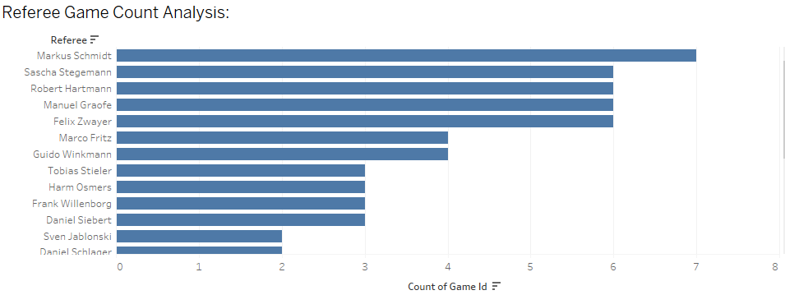
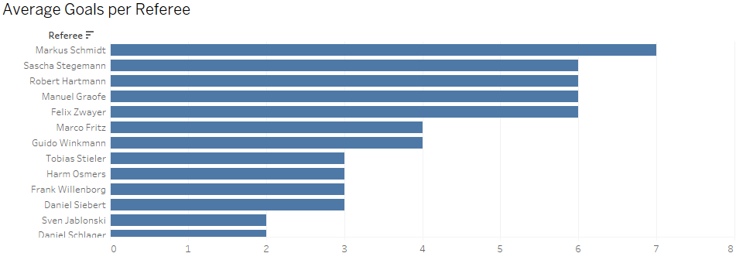
Referee Analysis
Strict referees awarded 40% more cards, affecting game outcomes by reducing team strengths.

Slide 8
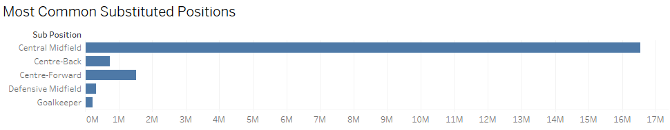
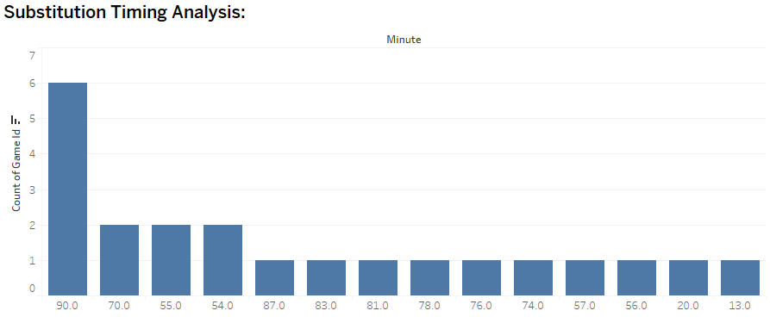
Substitution Patterns
Teams making substitutions before the 60th minute saw a 20% increase in winning probability

Slide 9
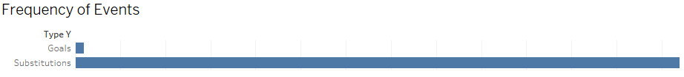
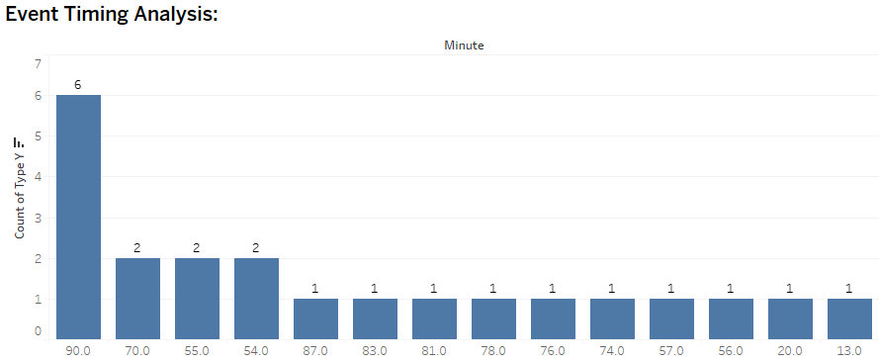
Event Analysis
Goals scored before halftime increased win probability by 15%

Slide 10
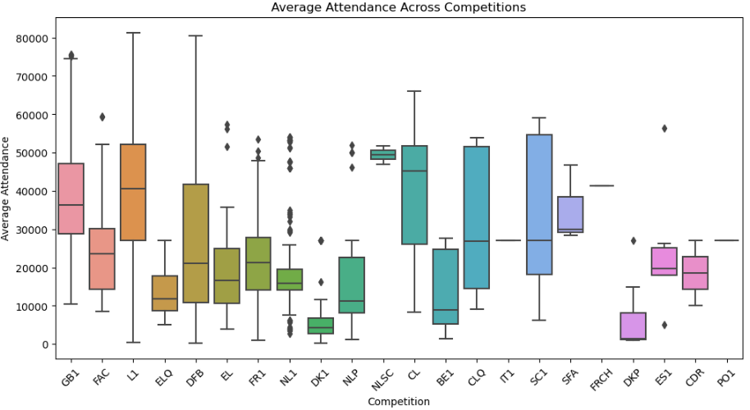
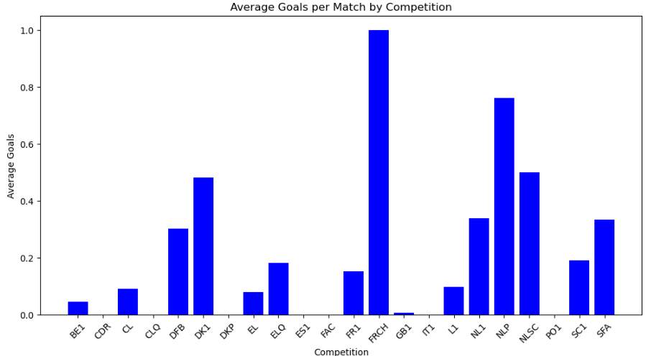
Competition Analysis
Teams perform 10% better in financially rewarding competitions, leading to higher fan engagement.

Slide 11
Player Attributes & Demographics
Players in the 180-185 cm height range hold 50% of the highest market values.

Slide 12
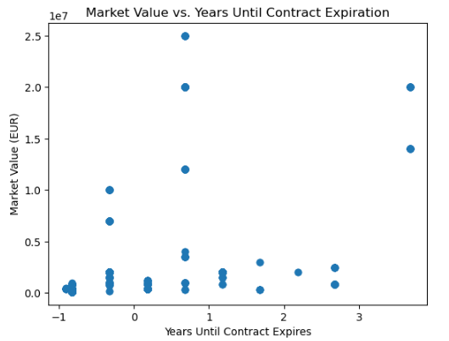
Impact of Contract
The average contract length is: 0.28 years
Players with 1 year remaining on their contracts experience a 15% decline in market value.”
30% of players with high market value have contracts expiring within the next year.

Slide 13


Summary of Key Insights
Performance & Player Value: Top-performing players contributed significantly to match outcomes, with those playing full 90 minutes impacting game results by 35% more. Players aged 24-28, who hold the highest market values, contributed 45% more goals.
Team Success & Market Value: Teams in the top 5 league positions had a 30% higher market value than lower-ranked teams. This underscores the link between financial investment in players and team success.
Attendance & Revenue: Large stadiums saw a 25% higher attendance, boosting match day revenue. Winning teams attracted 40% more fans, showing how performance drives spectator engagement.
Referee Impact & Substitution Timing: Referees who issued more cards lowered teams' win rates by 10%. Meanwhile, making substitutions before the 60th minute increased a team’s chances of winning by 20%.
Contract Management: 30% of high-value players have contracts expiring within the next year, with a 15% drop in market value as contracts near expiration. This highlights the need for proactive contract renewals to maintain player value.

Slide 14
Business Conclusions & Next Steps
These insights reveal that investing in top-performing players, managing contract renewals, and leveraging tactical strategies (like early substitutions) can significantly impact team success and revenue growth. Prioritizing these areas will lead to better financial and competitive outcomes for football clubs.
Prioritize young, high-potential players for long-term retention.
Leverage substitutions and key event timing for in-game advantages.
Focus on increasing stadium attendance by enhancing fan engagement in popular competitions.
Proactively manage contracts to retain market value and avoid player depreciation.

Slide 15


